Slide 1


Microprocessors and Assembly Language Spring 2020
Hamed Farbeh
farbeh@aut.ac.ir
Department of Computer Engineering
Amirkabir University of Technology
Lecture 8

Slide 2
Copyright Notice
Parts (text & figures) of this lecture are adopted from:
Design of Microprocessor-Based Systems (aka Embedded Systems Design and Implementation), Prabal Dutta, University of Michigan
UM10204: I2C-bus specification and user manual, Rev. 6 — 4 April 2014, User manual
ARMv7-M Architecture Reference Manual
Atmel | SMART ARM-based MCU DATASHEET, SAM3X / SAM3A Series, Atmel-11057C-ATARM-SAM3X-SAM3A-Datasheet_23-Mar-15
Microprocessors and Assembly Language, Spring 2020, AUT, Tehran, Iran

Slide 3
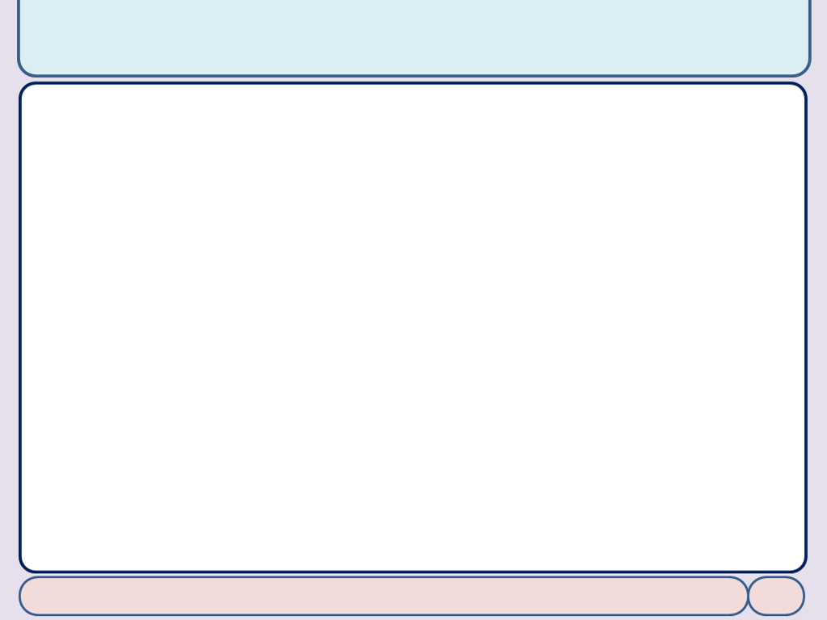
I²C-bus specification
Microprocessors and Assembly Language, Spring 2020, AUT, Tehran, Iran

Slide 4
I²C Description
Synchronous serial data link
Multi-master, multi-slave
Invented in 1982 by Philips Semiconductor (now NXP Semiconductors)
Widely used for attaching lower-speed peripheral ICs to processors and microcontrollers in short-distance
Appropriate for peripherals where simplicity and low manufacturing cost are more important than speed
https://en.wikipedia.org/wiki/I%C2%B2C
Microprocessors and Assembly Language, Spring 2020, AUT, Tehran, Iran

Slide 5
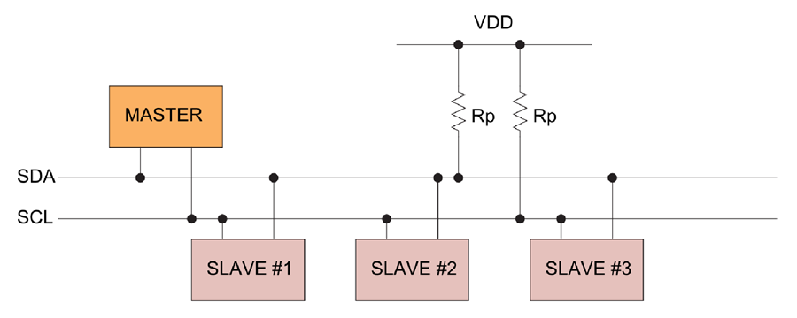
I²C Design
Two bidirectional open collector or open drain lines
open collector (or open drain): behaves like a switch that is either connected to ground or disconnected
Serial Data Line (SDA) and Serial Clock Line (SCL)
pulled up with resistors
7-bit address space (rarely-used 10-bit extension)
Bus speeds
100 kbit/s: standard mode
400 kbit/s: Fast mode
10 kbit/s: low-speed mode
1 Mbit/s: Fast mode plus
3.4 Mbit/s: High Speed mode
5 Mbit/s Ultra Fast-mode
https://en.wikipedia.org/wiki/I%C2%B2C
Microprocessors and Assembly Language, Spring 2020, AUT, Tehran, Iran

Slide 6
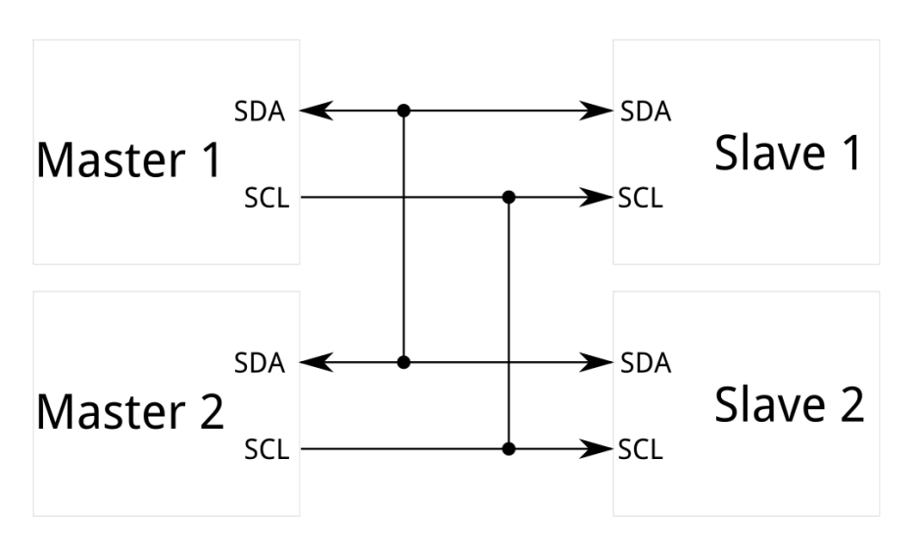
I²C Design
Operating roles
Master: generates the clock and initiates communication with slaves
Slave: receives the clock and responds when addressed by the master
Multi-master bus: any number of master nodes can be present
Master and slave roles may be changed between messages
https://en.wikipedia.org/wiki/I%C2%B2C
Microprocessors and Assembly Language, Spring 2020, AUT, Tehran, Iran

Slide 7
I²C Design
Potential modes of operation for a given bus device
Master – master node is sending data to a slave
Master receive – master node is receiving data from a slave
Slave transmit – slave node is sending data to the master
Slave receive – slave node is receiving data from the master
https://en.wikipedia.org/wiki/I%C2%B2C
Microprocessors and Assembly Language, Spring 2020, AUT, Tehran, Iran

Slide 8
I²C Data Transfer
Message delimiters
START and STOP signals
Are distinct from the data bits (0 and 1)
The master is initially in master transmit mode by sending a START followed by the 7-bit address of the slave
followed by a single bit representing whether it wishes to write (0) to or read (1) from the slave
The slave will respond with an ACK bit (active low for acknowledged)
If slave exists
The address and the data bytes are sent most significant bit first
https://en.wikipedia.org/wiki/I%C2%B2C
Microprocessors and Assembly Language, Spring 2020, AUT, Tehran, Iran

Slide 9
I²C Data Transfer
The start bit is indicated by a high-to-low transition of SDA
with SCL high
The stop bit is indicated by a low-to-high transition of SDA
with SCL high
All other transitions of SDA take place with SCL low
To write to the slave
The Master repeatedly sends a byte with the slave sending an ACK bit
To read from slave
Master repeatedly receives a byte from the slave, and send an ACK bit after every byte except the last one
https://en.wikipedia.org/wiki/I%C2%B2C
Microprocessors and Assembly Language, Spring 2020, AUT, Tehran, Iran

Slide 10
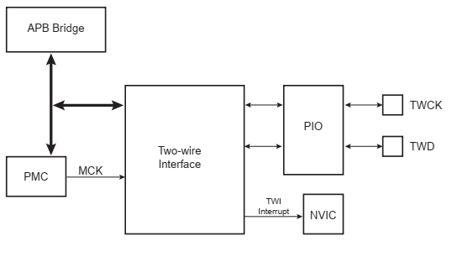
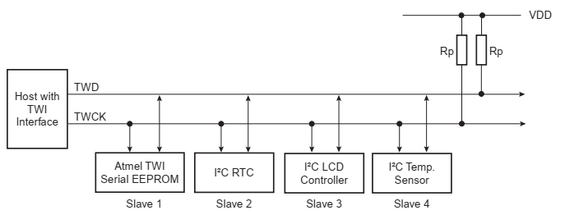
Two-wire Interface (TWI)
I2C-Compatible interface of ATMEL microcontroller
speeds of up to 400 Kbits/s
Chapter 33: Atmel | SMART ARM-based MCU DATASHEET, SAM3X / SAM3A Series, Atmel-11057C-ATARM-SAM3X-SAM3A-Datasheet_23-Mar-15
Microprocessors and Assembly Language, Spring 2020, AUT, Tehran, Iran

Slide 11
The End (for now)!
https://i2c.info/i2c-bus-specification
Microprocessors and Assembly Language, Spring 2020, AUT, Tehran, Iran

